Slide 1
ARVP Technology/Communication Update
Spring 2021 ROC Meeting
Region I ASSP

Slide 2
Chapter Document Storage
Society-Provided Google Drive
15GB
Upgradable as needed (chapter paid)
Allows for Cloud-Based storage of chapter documents (and possibly other things):
Chapter By-Laws
Financial Records
Chapter Meeting Minutes
COMT Tracker
Agendas
Presentations

Slide 4
Survey Results

Slide 5
Survey Results

Slide 6
Individual Chapter Platforms
Next year Region will cancel contract with GoTo Account
One host at a time with 19 different chapters using it.
Recommend Password Protection
Ideas on charging for meetings: $5 recommended donation to fund scholarship program
$150 - $200 / Year | $50 - $400 / Year

Slide 7
Virtual PDC/Symposium Options

Slide 9
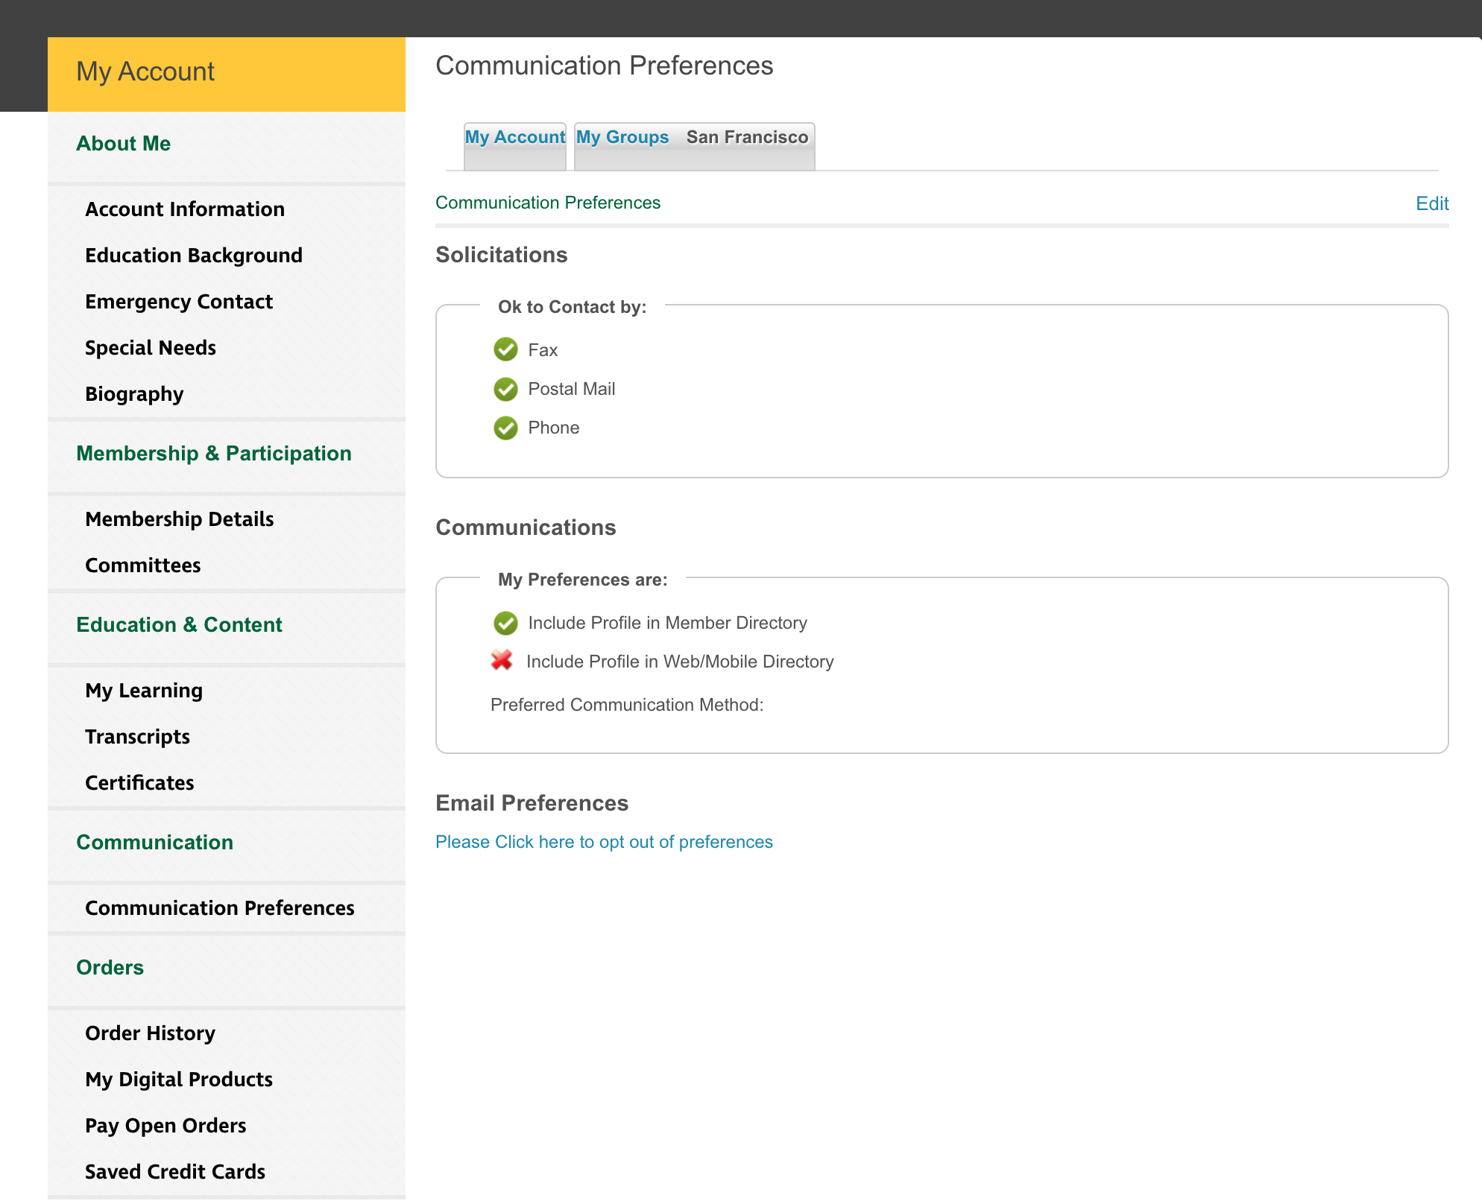
Communication Preferences

Slide 10
