Slide 1
ARVP Technology/Communication Update
Fall 2022 ROC Meeting
Region I ASSP

Slide 2
Chapter Leadership Training
ASSP Home > Community Leader Resources > Chapters > Chapter Communications > Chapter Leadership Training
On-Demand Leadership Training available for new board members/volunteers.
Training for specific roles (President, VP, Treasurer, etc.)
Additional Training & Resources available:
“Zoom Tools for more Engaging Virtual Programs Designed for Learners”
Transition Meeting Resources:
Transition Meeting Planning Worksheet
Sample Agenda’s
Officer Transition Checklist
Chapter Web Tools Transition Guide

Slide 3
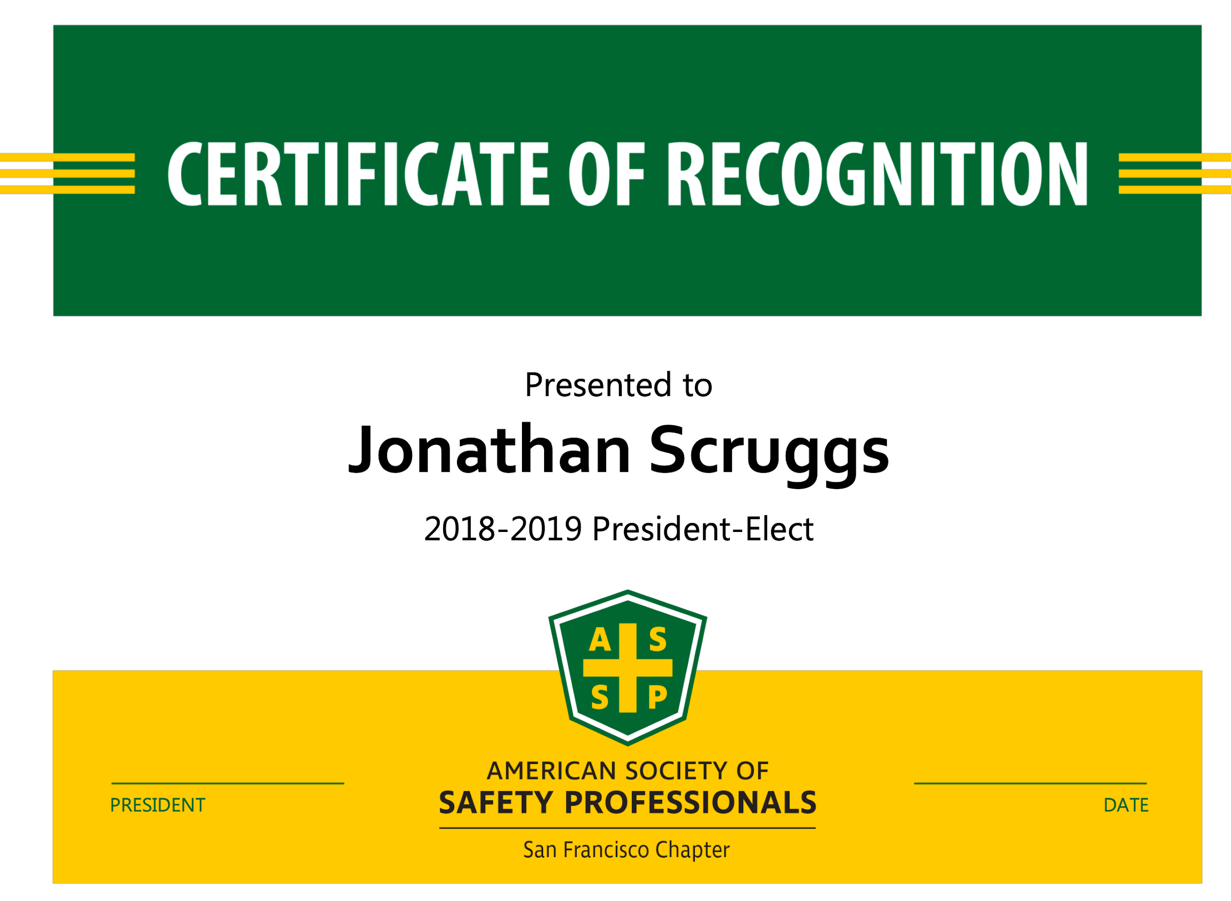
Chapter Communities Marketing Kit
ASSP Home > Community Leader Resources > Chapters > Chapter Communications > Chapter Communities Marketing Kit
Business Card
Certificate of Attendance/Recognition
Chapter Flyer
Letterhead
Name Badge
Presentation Slide Deck
Social Media Banners
ASSP Chapter & Region Logo files (high resolution)

Slide 4
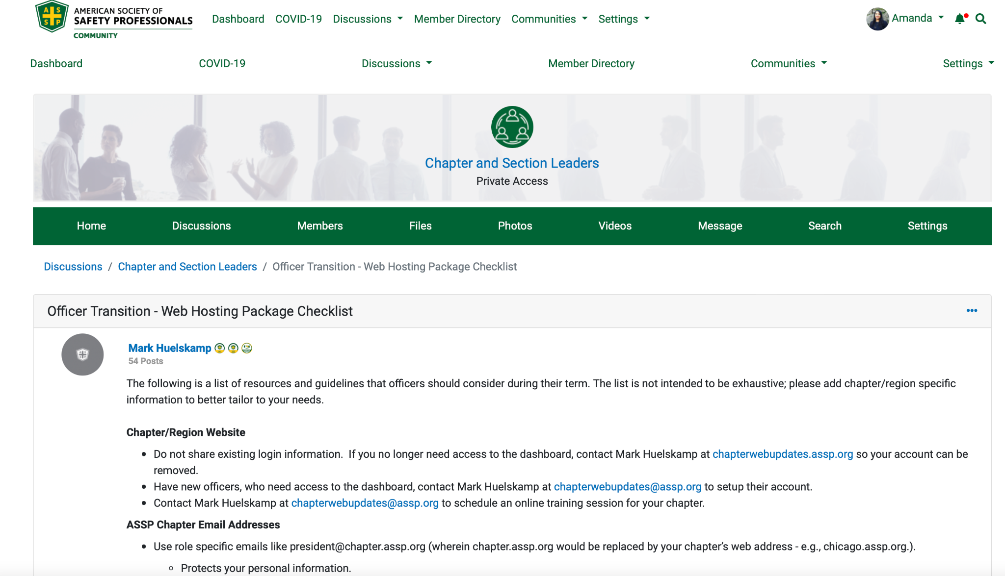
Chapter Technology Checklist
ASSP Communities > Discussions > Chapter and Section Leaders > Officer Transition - Web Hosting Package Checklist
Provides a list of resources & guidelines that officers should consider during their term.

Slide 5
Chapter Websites

Slide 6
Website - User Maintenance
Do not share existing wordpress login information!
Contact Mark Heulskamp to add/delete user accounts
chapterwebupdates@assp.org
Wordpress user training is available through Society

Slide 7
Chapter “Role” Emails - InMotionHosting
Society is now recommending chapters establish “role emails” for all officers!
Helps with Phishing
Protects Person/Business email address
More Professional
Helps with Transition

Slide 8
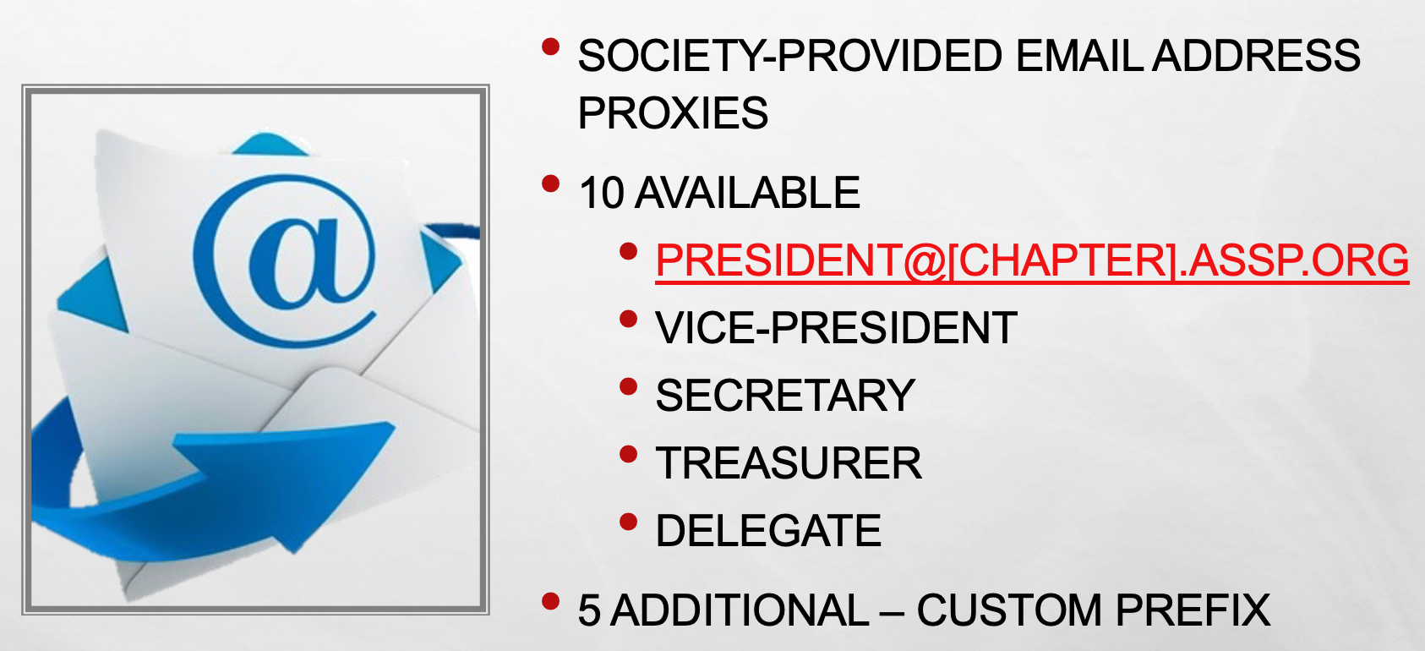
Chapter “Role” Emails

Slide 9
Chapter “Role” Emails – InMotionHosting
Maintain a list of usernames & passwords. (i.e. use google drive for this list)
Share appropriate information with incoming officers.
Have new officers visit: https://ded5439.inmotionhosting.com:2096/ to login
Update the recovery email address, forwarding address & password.
Provide updated information back to the chapter and update on list.
Role Specific Email Accounts FAQ
ASSP HOME > COMMUNITY LEADER RESOURCES > CHAPTERS > CHAPTER COMMUNICATIONS
> Role Specific Email Accounts FAQ

Slide 10
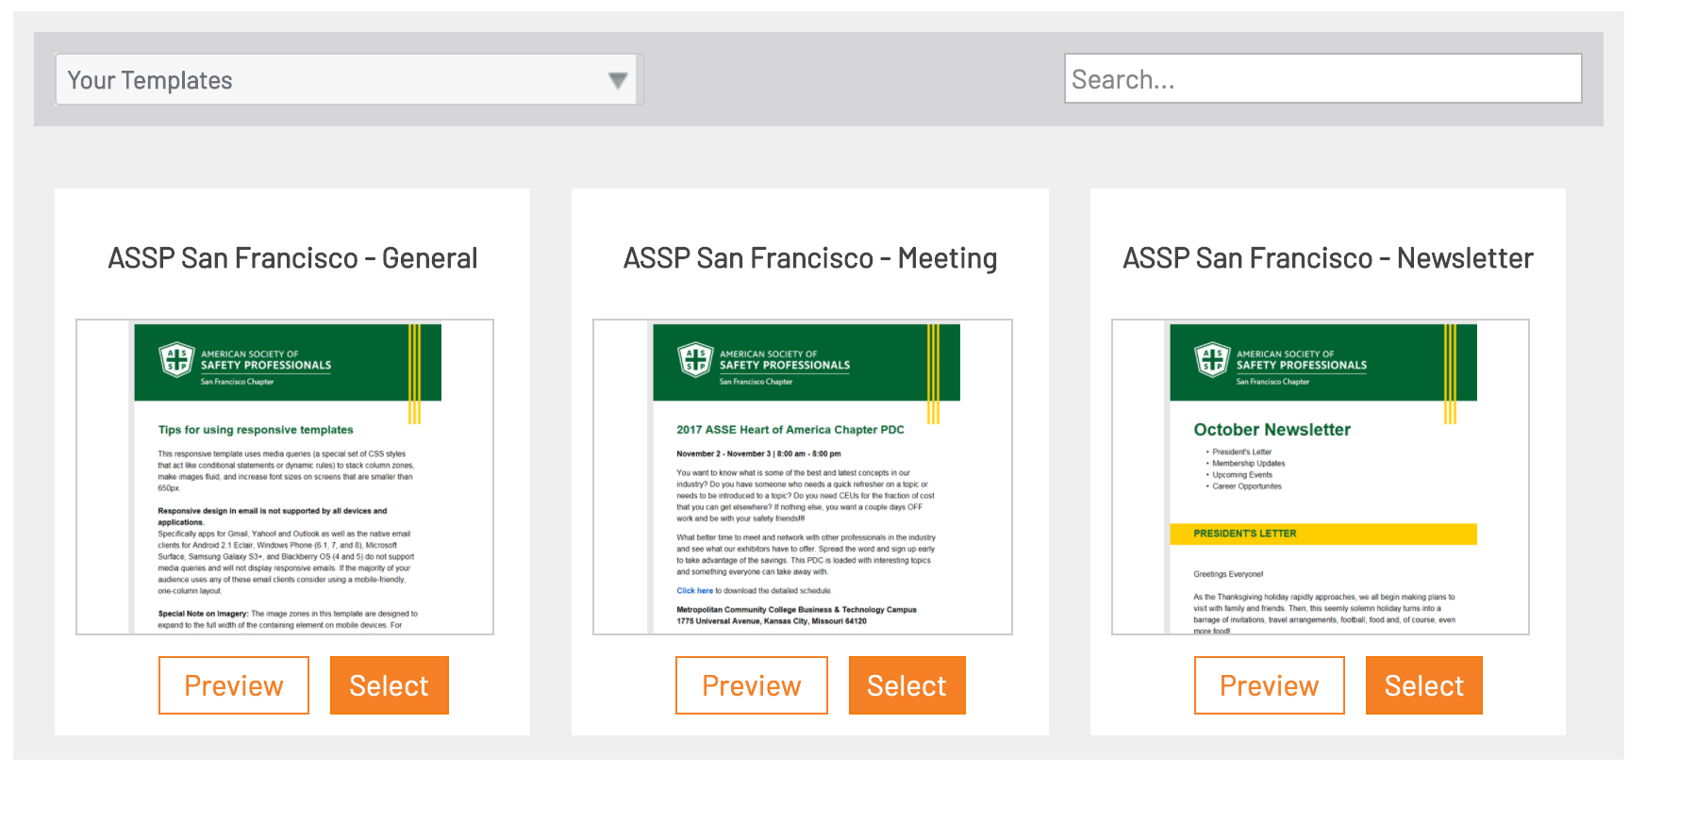
Magnet Mail/Higher Logic - Chapter Comm
One account shared among pertinent chapter officers!
To Access - http://www.magnetmail.net
Can update social media platforms with new content

Slide 11
Social Media Platforms
Social media accounts are not created/managed as part of your web hosting package. Here are some basic guidelines:
Create accounts as business/company pages. This allows you to post messages from the Real Magnet/Higher Logic and chapter website dashboard.
Use a chapter email address, like chapter gmail address or smail address such as updates@chapter.assp.org, to create the accounts. This will create a smooth transition
Visit society page to download your social media banners and chapter’s logo in high resolution format
ASSP HOME > COMMUNITY LEADER RESOURCES > CHAPTERS > CHAPTER COMMUNICATIONS

Slide 12
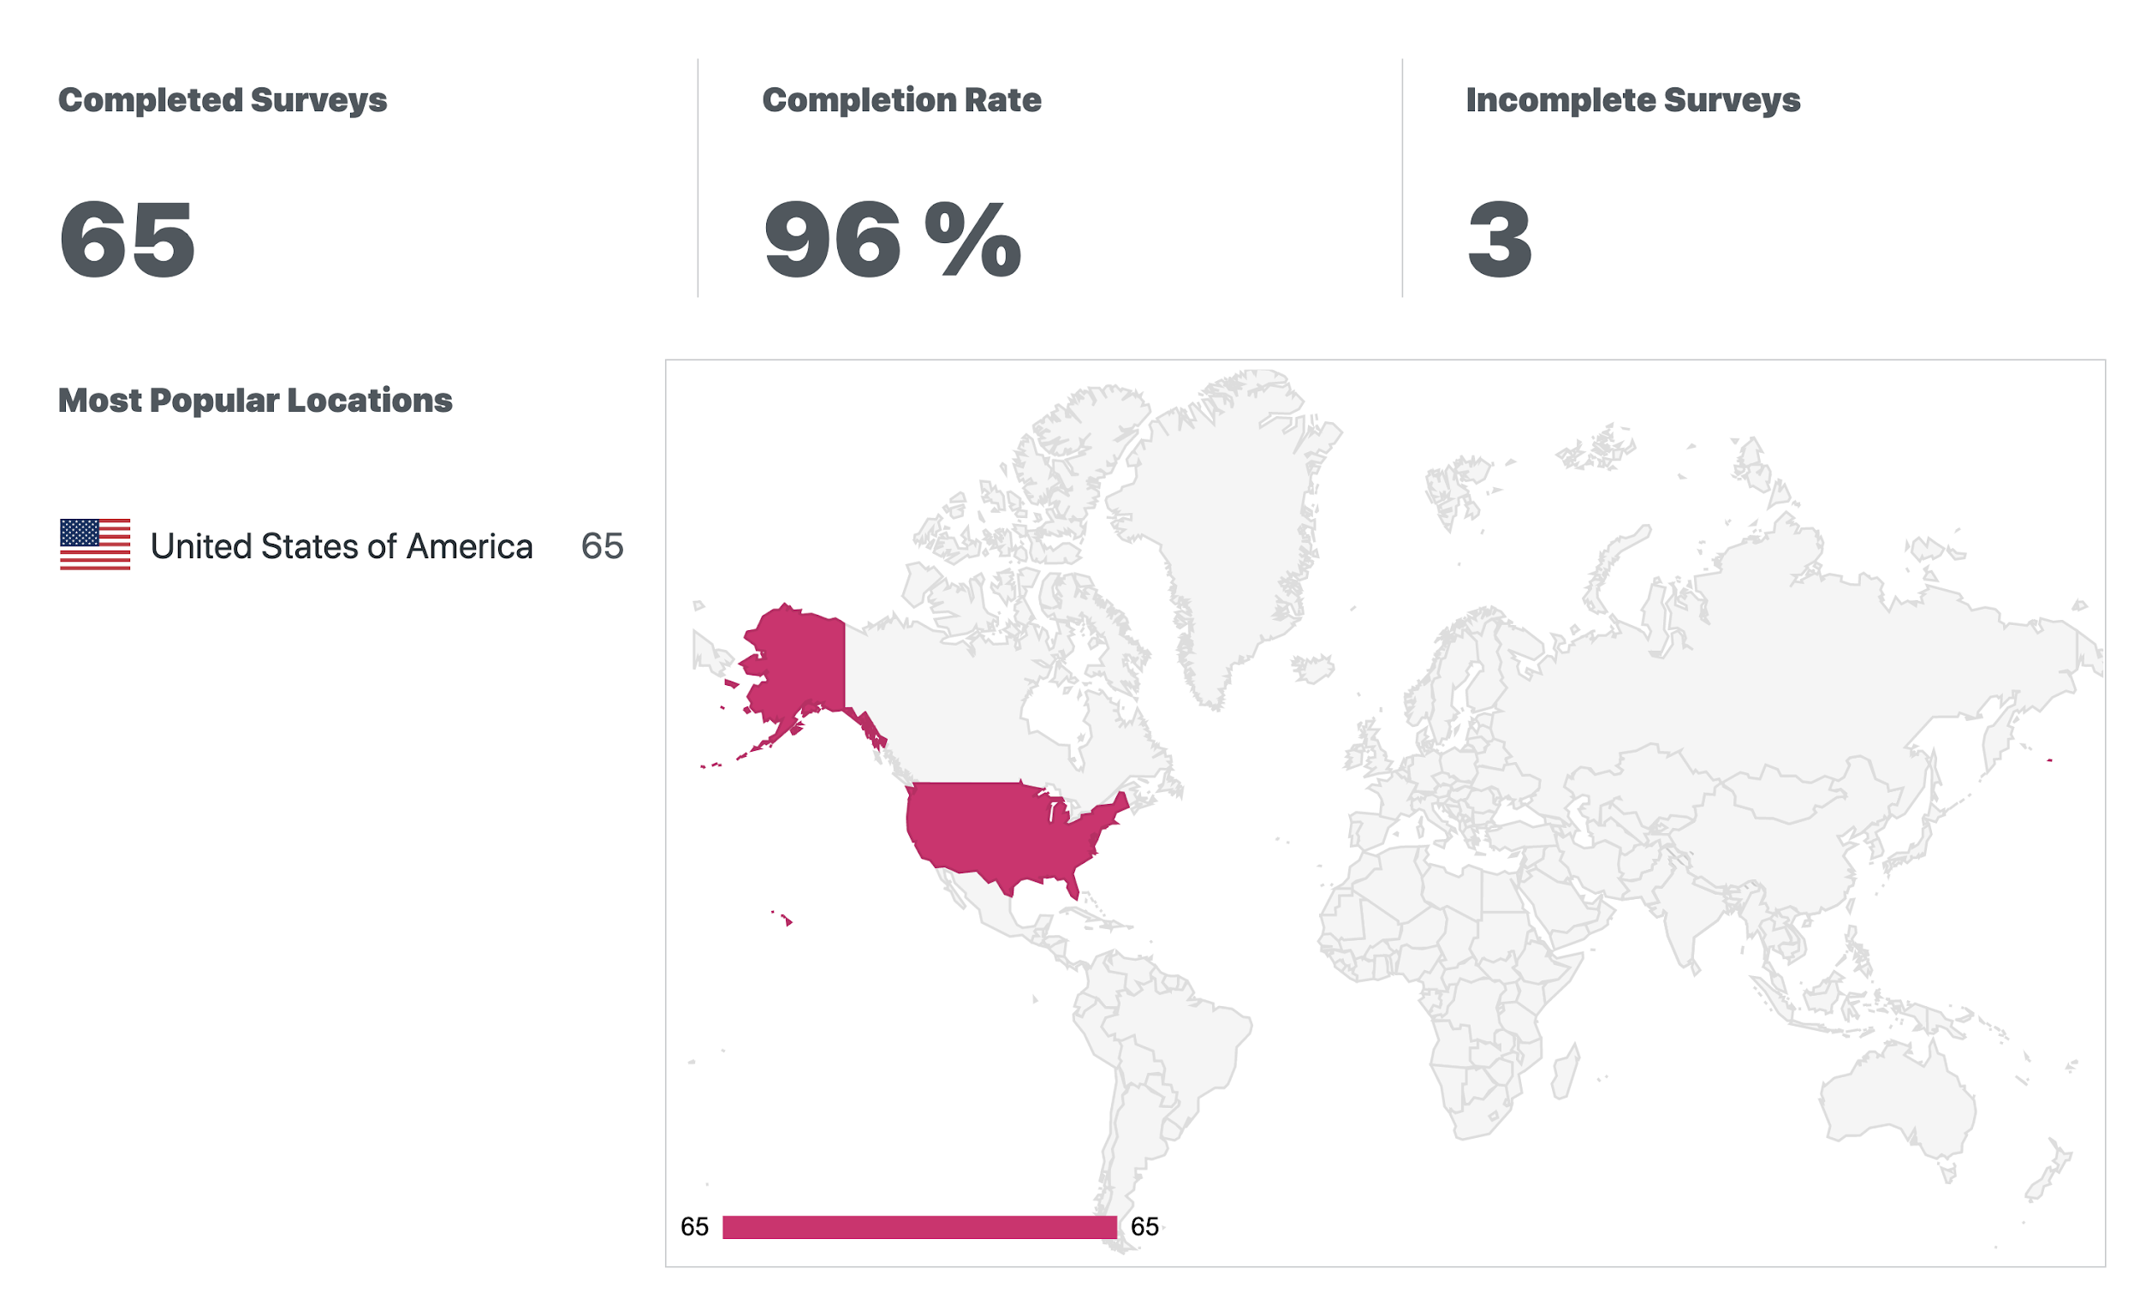
Poll Daddy
Annual Membership Survey
Meeting Evaluation Survey
General Membership Surveys

Slide 13
Society Provided Gmail Accounts
Chapter Document Storage (google drive):
Society-Provided Google Drive
15GB
Upgradable as needed (chapter paid)
Allows for Cloud-Based storage of chapter documents (and possibly other things):
Chapter By-Laws
Financial Records
Chapter Meeting Minutes
COMT Tracker
Agendas
Presentations

Slide 14
Society Provided Gmail Accounts
Google Calendar
Google Meet (1-hour free)
Can be used to sign up for other chapter related accounts (Don’t use personal email addresses!)
Paypal, Square, etc.
Chapter Bank Account
Virtual Meeting Platforms (zoom)
Overall, makes officer transition much easier!

Slide 15
Virtual Meetings & Resources
It is highly recommended that your chapter purchase some form of platform to run virtual meetings with your members.
Provides opportunity to interact with all chapter members & gives options for members to attend meetings.
$150 - $200 / Year | $50 - $400 / Year

Slide 16
Virtual Meeting Best Practices, Cont.
Host/Presenter Etiquette | Attendee Etiquette
TEST the software early: Make sure you know how to login and and allow other to become the presenter. | Hello, and thank you for joining today’s webinar. Here are a few housekeeping items before we get started with the presentation. This presentation is being recorded and will be available on the Chapter Website. Please mute your audio when you are not contributing to the conversation. Feedback from computers and cell phones can be distracting to the group and presenter. Please use the Chat or Questions feature to submit any questions you may have during today’s presentation. I will monitor your questions and the presenter will answer them throughout or at the end of the presentation. [Introduce Presenter]
TEST your microphone
Use high-speed internet connection
Shut down other applications and programs
Find a quiet, comfortable place with minimal distractions
Find good lighting
Review attendee etiquette “script” at the beginning of the meeting
Manage the Chat Function along the way or at the end but make sure your attendees know which one you intend to do.

Slide 17
Virtual Meeting Best Practices, Cont.
Engagement Tools
Polls - Poll Daddy or GoToWebinar
Surveys/Evaluations - Poll Daddy or GoToWebinar
Question/Chat Feature
Include handouts in the Handout Feature
Videos - Email out link & post on chapter website

Slide 18
Chapter Nominations & Elections
ASSP Home > Community Leader Resources > Chapters > Chapter Management > Chapter Nominations and Elections
Notes:
Contains templates for succession planning resources, recruitment & nomination tools & election management tools. This will assist with the chapter eballot setup process.

Slide 19
Society Community Site
community.assp.org
Join the general discussion forums and participate in the forums for the practice specialty and other common interest groups they belong to.
Can connect with other chapter leaders to ask questions and share best practices in the chapter and section leader group

Slide 20
Protect Your Chapter From Spear-Phishing Attacks
Notes:
Welcome. This presentation covers how to protect your chapter from spear-phishing attacks.

Slide 22
Overview
How spear-phishing attacks work
Spotting a spear-phishing attack
Protecting your chapter
Responding to attacks
Notes:
Today we will describe how a spear-phishing attack works, how to spot these attacks, what you can do to protect your chapter, and what you should do when your chapter is targeted.​

Slide 23
Spear-phishing attack
Targeted email message that appears to come from a trusted source requesting money or information
Notes:
Spear-phishing attacks are targeted email messages that come from a trusted source, likely someone the target knows personally and generally someone in a position of authority. The message content asks for a money transfer to pay a vendor, or may ask for information like account and log in details.​
​
How it works: Scammers use robots to scan all types of websites across the Internet and pull the information they need for the attack. In the case of ASSP chapters, these robots are scanning your chapter website and pulling the name, position, and email contact of chapter leaders – typically the president and treasurer, though other leaders may receive messages, as well. The scammers then use this information to send their targeted messages. Being spoofed or receiving one of these messages usually does not mean your email has been hacked – it just means your information was pulled from your chapter’s website.​
​
Spear-phishing attacks and other spam messages are certainly a nuisance that comes with email communication and posting the names and contact information of your chapter leaders on your chapter’s website does impact the spam in your inbox. However, your good work in keeping your website up-to-date with this information is important as you serve ASSP members – it helps your chapter members know who their local leaders are and how to get in touch with you when they want to connect. ​
​
Spam filters can block some scam messages, but spammers are increasingly finding ways around the filters. It is every email user’s responsibility to be vigilant.

Slide 24
Spotting a spear-phishing attack
Notes:
Let’s take a look at what you should be watching your inbox for.​

Slide 25
Spear-phishing message: Example 1
From: Arielle Semmel [mailto:p52351@cox.net] ​ Sent: Monday, June 11, 2018 10:05 AM​ To: Mark Huelskamp <ChapterWebUpdates@assp.org>​ Subject: Hello Mark​
​
I need you to process an outgoing payment, can we process via wire transfer or check today? Let me know the details you need.​
Thanks,​ Arielle​
Notes:
This is an example spear-phishing message based on an actual message received by an ASSP chapter. In this case, a scammer is posing as Arielle Semmel to target Mark Huelskamp.​
​
There are some clear ways to for Mark to tell that this message did not really come from Arielle and is probably spam.​

Slide 26
Spear-phishing message: Example 1
From: Arielle Semmel [mailto:p52351@cox.net] ​ Sent: Monday, June 11, 2018 10:05 AM​ To: Mark Huelskamp <ChapterWebUpdates@assp.org>​ Subject: Hello Mark​
​
I need you to process an outgoing payment, can we process via wire transfer or check today? Let me know the details you need.​
Thanks,​ Arielle​
Notes:
First and most obvious, Mark can check the return email address.​
​
While a spammer can spoof Arielle’s name in the text field of the email, it’s harder to spoof her actual email address. Mark can look at the email address listed – or hit “reply” to show the email address if it does not already appear. Here he can see that this is clearly not Arielle’s email address, even though it’s made to look like it could be if you just glance at it. But a closer look reveals a spelling error (chapters) and an incorrect domain name.​
​
If Mark still isn’t sure whether or not this is Arielle – maybe he thinks she’s using an alternate email address – he can pick up the phone and give her a call. Or, at the very least, he can send a new message to her at the email address she usually sends email messages from to ask if she’d sent him an email asking for payment.​

Slide 27
Spear-phishing message: Example 1
From: Arielle Semmel [mailto:p52351@cox.net] ​ Sent: Monday, June 11, 2018 10:05 AM​ To: Mark Huelskamp <ChapterWebUpdates@assp.org>​ Subject: Hello Mark​
​
I need you to process an outgoing payment, can we process via wire transfer or check today? Let me know the details you need.​
Thanks,​ Arielle​
Notes:
Mark can also look to see who else is included on this message.​
​
Mark and Arielle follow a best practice to include other team members that are involved on a particular project on their messages – especially the messages that involve requests for payment or account information. This practice helps them make sure everyone is in the loop and provides transparency to the team about what they are up to.​
​
Here, Mark can see that no one else from their team is copied on this message. Mark knows that sometimes Arielle gets busy and may miss adding the cc field, but he also knows that it’s unusual for her to do that and so he knows to give her a call to confirm the request before he sets up a payment.​

Slide 28
Spear-phishing message: Example 1
From: Arielle Semmel [mailto:p52351@cox.net] ​ Sent: Monday, June 11, 2018 10:05 AM​ To: Mark Huelskamp <ChapterWebUpdates@assp.org>​ Subject: Hello Mark​
​
I need you to process an outgoing payment, can we process via wire transfer or check today? Let me know the details you need.​
Thanks,​ Arielle​
Notes:
Finally, Mark can take a look at the content of the message.​
​
Scammers will send vague messages that include few details about their request.​
​
Mark knows that when Arielle asks him to help with a payment, she typically includes details about who the vendor is, what exact project or event the expense is for, when the expense was approved and by who, and supporting documents like an invoice or check request form. Mark doesn’t see any of that information in this message, so he knows this is a suspicious message.​

Slide 29
Spear-phishing message: Example 2
From: Arielle Semmel <program@chapter.assp.org> Sent: Monday, March 2, 2020 12:23 PM​ To: Geri Golonka <ggolonka@assp.org>​ Subject: Hello Geri
​
I need you to purchase three gift cards for the local veterans group today. Let me know when you’re done and I’ll send you the details.
Thanks,​ Arielle​
Notes:
Here’s another example based on an actual message chapters have received. This time the spammer posing as Arielle is targeting Geri.
What in this message raises red flags for you?

Slide 30
Spear-phishing message: Example 2
From: Arielle Semmel <program@chapter.assp.org> Sent: Monday, March 2, 2020 12:23 PM​ To: Geri Golonka <ggolonka@assp.org>​ Subject: Hello Geri
​
I need you to purchase three gift cards for the local veterans group today. Let me know when you’re done and I’ll send you the details.
Thanks,​ Arielle​
Notes:
Once again, we have a vague message that isn’t sent to everyone on the team.
But this scammer has gotten clever – they’ve made it look like the message is coming from Arielle’s actual email address by manipulating the plain text in the from field.

Slide 31
Spear-phishing message: Example 2
From: Geri Golonka <ggolonka@assp.org>​ Sent: Monday, March 2, 2020 12:23 PM​ To: p52351@cox.net Subject: RE: Hello Geri
​
I
-Geri
____________________________________________________________
I need you to purchase three gift cards for the local veterans group today. Let me know when you’re done and I’ll send you the details.
Thanks,​ Arielle​
Notes:
But Geri knows she can double check the sender’s email by clicking reply. When she does that, she can see that the email did not actually come from Arielle.

Slide 32
Protecting your chapter
Notes:
Now that we know how to spot a spear-phishing attack, let’s talk about some ways you can protect your chapter.​

Slide 33
Best Practices
Verify email address
Utilize chapter emails from ASSP
ex. president@chapter.assp.org
Contact the “sender” directly
Notes:
If a colleague or friend – or even a business – sends you an email asking for a money transfer, password, or other information;​
​
Verify the email address matches the one the sender usually uses to contact you.​
​
You can get extra protection by utilizing role specific email addresses from ASSP. As part of the ASSP web hosting account, each chapter is offered and encouraged to use role specific email addresses for your chapter. ​
​
While the plain text in the from field can be manipulated, actual email addresses cannot be spoofed. With a role specific ASSP chapter email address, you will see @[your chapter’s name].assp.org in the email address when you click reply. Using chapter emails will also protect your personal information and help during the officer transition each year.​
​
Call or send a separate email to the person to verify if it was really that person who contacted you. The same goes for banks and businesses. Legitimate correspondence won't email you asking for same day payment, passwords, or account numbers. If you think the email might be real, call the person or company and ask.

Slide 34
Best Practices
Follow financial management policies & procedures from Chapter Accounting Standard Operating Guidelines
Prior approval documentation
Reference purpose of request
Include relevant team members
Notes:
Finally, you should always verify that any request for payment or information follows the financial management policies and requirements at your chapter, as outlined in the Chapter Accounting Standard Operating Guidelines. The Chapter Accounting Standard Operating Guidelines aim to help chapters ensure that assets are safeguarded; that financial statements align with generally accepted accounting principles; and that finances are managed with responsible stewardship. ​
​
As a chapter leadership team, have a discussion about how you will operationalize these guidelines – particularly as it relates to your email communications.​
​
There are several practices listed in the guidelines that will help you spot and evade spear-phishing attacks.​
​
All disbursements of chapter monies must be pre-approved by a quorum of the executive committee. In addition, any contract that will exceed $1,500 over the course of the year must be approved by both your chapter’s executive committee and your regional vice president. This approval must be documented, for example, in meeting minutes. The purpose of the payment – for example, a meeting venue deposit – and the approval of those funds should be referred to in any related check requests. If you receive a request for payment that you don’t ever remember discussing as a team and that does not reference prior approval, you should be suspicious.​
​
In addition, include relevant team members in funding discussions, whether in-person or by email. While your chapter’s treasurer may take the lead in financial matters, every member of the executive committee has a fiduciary responsibility to manage the chapter’s finances well. Including team members in funding discussions and requests ensures that everyone is participating, that everyone is transparent in their actions, and keeps everyone informed about chapter business. It also helps you question payment or information requests that don’t include key stakeholders, as is usually the case in spear-phishing attacks.​

Slide 35
Responding to attacks
Notes:
Now that you know what you look for and how you can protect your chapter, let’s talk about what to do with spear-phishing attacks.​

Slide 36
What to do…
When you get the email:
Delete the message
Report the email address to the email service provider
Do NOT send a reply
If your chapter has sent payment:
Inform your leadership team
Report the fraud to the authorities
Report the incident to your financial institution
Report incident to your area director, regional vice president and ASSP chapter services
Notes:
If you do receive a spear-phishing email, your best course of action, as with all spam messages, is to ignore and delete the email. You can also report the email address to the email service provider so they can take the appropriate action following their usage protocols. Do not respond to the message – either to ask them to stop sending the messages or to try to trick them into giving away their true identity. This confirms for the scammers that they have a live person on the other end and will likely result in them increasing their efforts – not just at your chapter, but at ALL ASSP chapters and regions.
​
If you find that your chapter has been tricked by the scam and sent payment:​
Inform your leadership team. This will help them keep an eye out for similar messages – they should expect to see an increase. It will also help kick start the conversation about how your chapter wants to review its procedures and policies to prevent falling victim to any future attacks.​
Report the fraud to the authorities. While it is rare for authorities to be able to recover funds lost through email scams, it is helpful to have a police report on file for future financial audits.​
You may also want to report the incident to your financial institution, which can help you if the scammers try to access your account.​
You should also report the incident to your Area Director, Regional Vice President, and ASSP Chapter Services to help you look at ways to protect your chapter in the future. In addition, once a scammer is successful at one ASSP site, they will likely target more – sharing your experience enables ASSP to warn other chapters to be on the look-out for an increase in these messages and to take extra precautions.

Slide 37
Contacts
Chapter Web Services | Mark Huelskamp chapterwebupdates@assp.org
Region 1 | Amanda Shin amanda.shin@gmail.com

Slide 38
Questions?

